Slide 1


Aubay – hackathon 2022
GREEN TEAM

Slide 2
GREEN TEAM
Daniel Galvão de Azevedo
Eduardo Coelho da Silva Porto Gonçalves
José Aderbal Aragão Filho
Thiago Noronha Caldas

Slide 3

CHALLENGE
Is to develop a notification center for several channels (SMS, Email, WhatsApp, Teams, Signal, Telegram, etc.) of Aubay messages for employees. The application must have an interface for introducing contacts, messages by channels, data import through CSV and Aubilous reports of the success rate per message sent per channel.

Slide 4
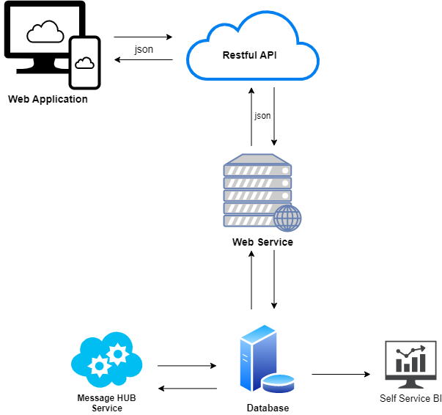
Solution
Restful API

Slide 5


Global technology
Smart Product
Voice Recognition
Artificial Intelligence
VR

Slide 6
Global technology
Smart Product
Voice Recognition
Artificial Intelligence
VR

Slide 7
Uses of Virtual Reality

Slide 8
Network Technology
Problem Solving
Algorithm
Automation

Slide 9
DEMOSTRATION

Slide 10

Thank You!

